Slide 1
CREAM & PASTEL PALETTE HEALTHCARE CENTER CHARACTERS
Here is where your presentation begins

Slide 2
CONTENTS OF THIS TEMPLATE
This is a slide structure based on a healthcare center presentation
You can delete this slide when you’re done editing the presentation
FONTS | To view this template correctly in PowerPoint, download and install the fonts we used
USED AND ALTERNATIVE RESOURCES | An assortment of graphic resources that are suitable for use in this presentation
THANKS SLIDE | You must keep it so that proper credits for our design are given
COLORS | All the colors used in this presentation
INFOGRAPHIC RESOURCES | These can be used in the template, and their size and color can be edited
CUSTOMIZABLE ICONS | They are sorted by theme so you can use them in all kinds of presentations
For more info:
SLIDESGO | BLOG | FAQS
You can visit our sister projects:
FREEPIK | FLATICON | STORYSET | WEPIK | VIDEVO

Slide 3
TABLE OF CONTENTS
01
02
03
04
OUR
CENTER
KEY NUMBERS
You can describe the topic of the section here
You can describe the topic of the section here
PATIENT CARE
ACCOMPLISHMENTS
You can describe the topic of the section here
You can describe the topic of the section here

Slide 4
TABLE OF CONTENTS
01
02
03
04
05
06
OUR CENTER
PATIENT CARE
KEY NUMBERS
You can describe the topic of the section here
You can describe the topic of the section here
You can describe the topic of the section here
HEALTH AREAS
MEDICAL STAFF
INSTITUTION
You can describe the topic of the section here
You can describe the topic of the section here
You can describe the topic of the section here

Slide 5
INTRODUCTION
You can give a brief description of the topic you want to talk about here. For example, if you want to talk about Mercury, you can say that it’s the smallest planet in the entire Solar System

Slide 6
01
OUR CENTER
You can enter a subtitle here if you need it

Slide 7
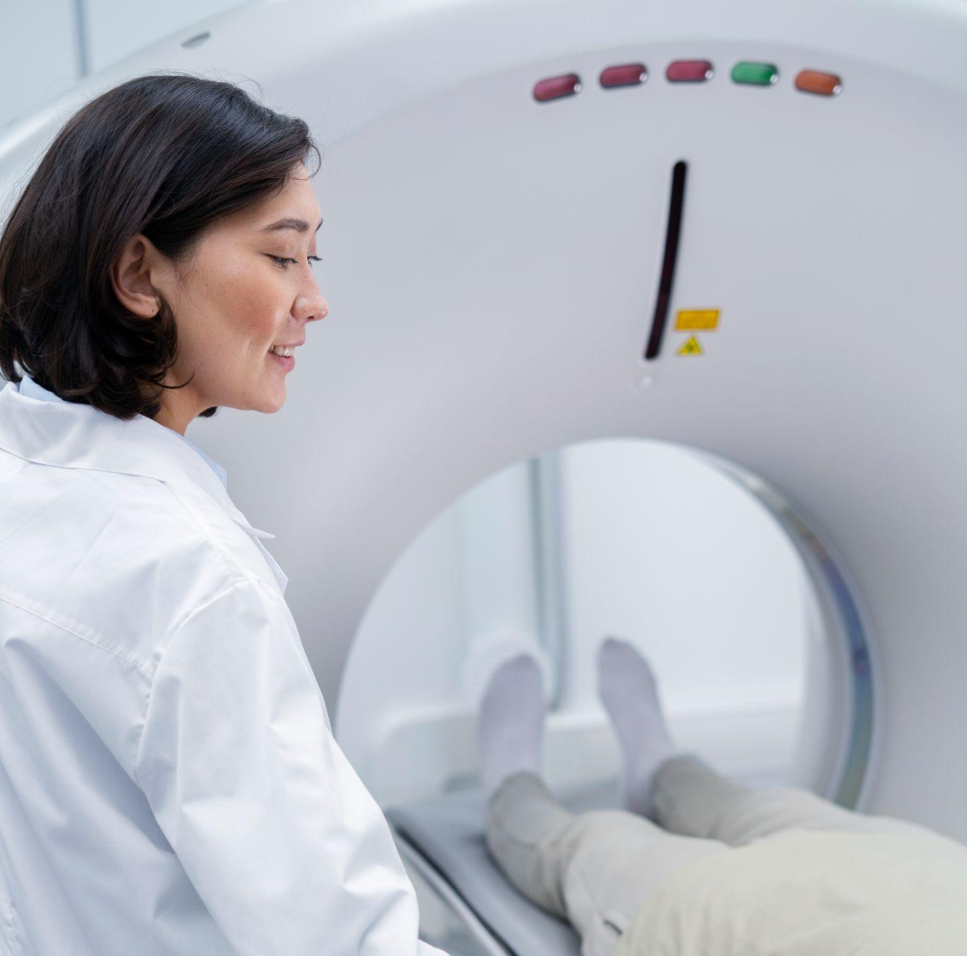
OUR CENTER
Do you know what helps you make your point clear? Lists like this one:
They’re simple
You can organize your ideas clearly
You’ll never forget to buy milk!
And the most important thing: the audience won’t miss the point of your presentation

Slide 8
OUR CENTER
MARS
VENUS
MERCURY
Despite being red, Mars is actually a cold place. It’s full of iron oxide dust
Venus is the second planet from the Sun. It’s hot and has a poisonous atmosphere
Mercury is the closest planet to the Sun and the smallest one in the Solar System

Slide 9
MISSION & VISION
MISSION
VISION
Mercury is the closest planet to the Sun and the smallest one in the Solar System—it’s only a bit larger than the Moon
Venus has a beautiful name and is the second planet from the Sun. It’s terribly hot and its atmosphere is poisonous

Slide 10
IMPORTANT VALUES
SERVICE
EMPATHY
Despite being red, Mars is actually a cold place. It’s full of iron oxide dust
Venus has a beautiful name and is the second planet from the Sun
RESPONSABILITY
Mercury is the closest planet to the Sun and the smallest one

Slide 11
CENTER FACTS
MARS
JUPITER
It's full of iron oxide dust, which gives the planet its reddish cast
It’s a gas giant and the biggest planet in the Solar System
MERCURY
SATURN
Mercury is the closest planet to the Sun and the smallest one
Saturn is composed mostly of hydrogen and helium
NEPTUNE
VENUS
Neptune is the fourth-largest planet in the Solar System
Venus has a beautiful name, but also very high temperatures

Slide 12
02
PATIENT CARE
You can enter a subtitle here if you need it

Slide 13
—SOMEONE FAMOUS
“This is a quote, words full of wisdom that someone important said and can make the reader get inspired”

Slide 14
PATIENT CLASSIFICATION
VITAL SIGNS
PATIENT PROFILE
Mercury is a small planet
Mars is made of basalt
WEIGHT & HEIGHT
MEDICAL RECORD
Venus has a beautiful name
Jupiter is the biggest planet

Slide 15
DIFFERENT TREATMENTS
MERCURY
VENUS
EARTH
Mercury is the smallest planet
Venus has a beautiful name
Earth is the only planet with life
NEPTUNE
PLUTO
JUPITER
It’s very far away from the Sun
It’s considered a dwarf planet
Jupiter is the biggest planet

Slide 16
OTHER SPECIAL CARES
MERCURY
MARS
Mercury is the smallest planet
Mars is actually a cold place
SATURN
EARTH
Saturn is the ringed planet
Earth is the only planet with life
JUPITER
VENUS
Jupiter is the biggest planet
Venus has a beautiful name

Slide 17
03
KEY NUMBERS
You can enter a subtitle here if you need it

Slide 18
KEY NUMBERS
50,000
20,000
5,000
This is the number of total visitors we had last month
This is the number of patients we had last month
This is the number of transplants performed so far

Slide 19
KEY NUMBERS
PATIENTS | 50,000 | Mercury is a small planet
VISITORS | 20,000 | Venus has a beautiful name
TRANSPLANTS | 5,000 | Mars is made of basalt
DONATORS | 3,000 | Jupiter is a gas giant

Slide 20
150k+
Lives saved and cared since the Healthcare Center first opened to the public

Slide 21
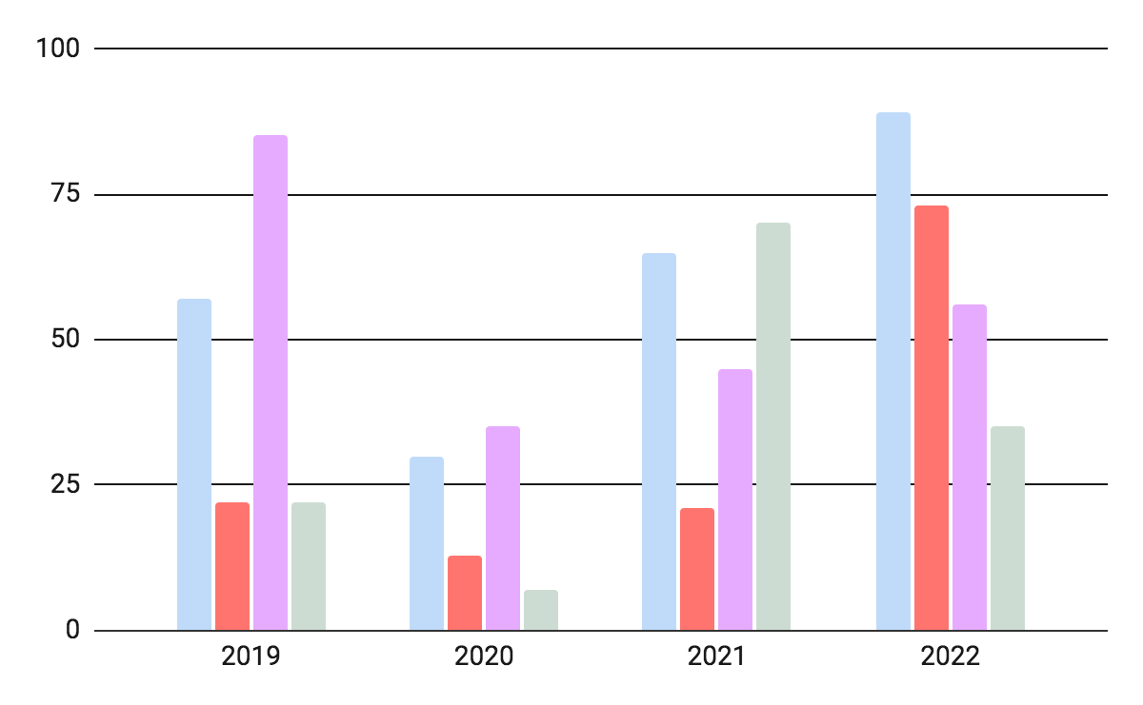
OUR STATISTICS
MERCURY
MARS
Mercury is a small planet
Mars is made of basalt
VENUS
JUPITER
Venus has a beautiful name
Jupiter is a gas giant
Follow the link in the graph to modify its data and then paste the new one here. For more info, click here

Slide 22
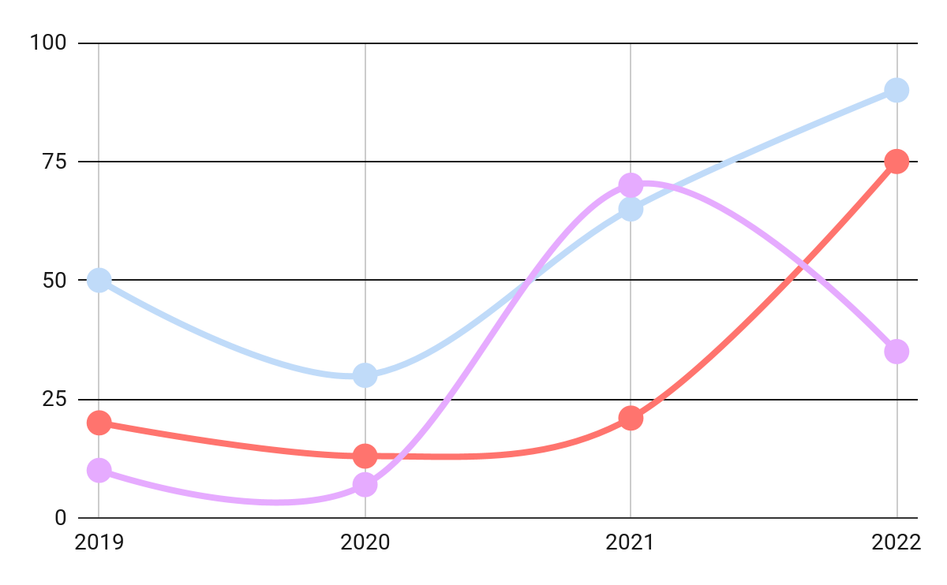
OUR STATISTICS
MERCURY
+40%
Mercury is a small planet
VENUS
+55%
Venus has a beautiful name
MARS
+25%
Mars is made of basalt
Follow the link in the graph to modify its data and then paste the new one here. For more info, click here

Slide 23
HEALTH AREAS
04
You can enter a subtitle here if you need it

Slide 24
A BRIEF STORY
Venus has a beautiful name and is the second planet from the Sun. It’s terribly hot, even hotter than Mercury, and its atmosphere is extremely poisonous. It’s the second-brightest natural object in the night sky after the Moon

Slide 25
A BRIEF STORY
01
02
03
04
SATURN
MARS
VENUS
MERCURY
It’s composed of hydrogen and helium
Despite being red, Mars is a cold place
Venus is the second planet from the Sun
Mercury is the closest planet to the Sun

Slide 26
A PICTURE ALWAYS REINFORCES THE CONCEPT
Images reveal large amounts of data, so remember: use an image instead of a long text. Your audience will appreciate it

Slide 27
MILESTONES REACHED
MERCURY
2005
MARS
2018
EARTH
Mercury is a small planet
Mars is made of basalt
Earth harbors lots of life
2001
VENUS
2015
JUPITER
2022
Venus has a beautiful name
Jupiter is a gas giant

Slide 28
MILESTONES REACHED
20XX
MERCURY
Mercury is a small planet
20XX
EARTH
Earth is the planet with life
20XX
MARS
Mars is made of basalt
20XX
VENUS
Venus has a beautiful name
20XX
JUPITER
Jupiter is a gas giant

Slide 29
OUR PROCESS
VENUS
JUPITER
Venus is the second planet from the Sun
It’s the biggest planet in the Solar System
MARS
SATURN
Despite being red, Mars is a cold place
Saturn is a gas giant and has several rings

Slide 30
OUR PROCESS
01
MARS
03
MERCURY
Despite being red, Mars is a cold place
Mercury is the closest planet to the Sun
02
VENUS
It’s terribly hot and it has a beautiful name

Slide 31
PATIENT CARE
Earth is the third planet from the Sun and the only one that harbors life in the Solar System. This is where we all live on

Slide 32
PATIENT CARE
EARTH
It’s the planet where we live
VENUS
MARS
Venus has a beautiful name
PATIENT
Mars is made of basalt
JUPITER
Jupiter is a gas giant

Slide 33
MEDICAL STAFF
05
You can enter a subtitle here if you need it

Slide 34
AREAS WE COVER
 | JUPITER | CERES | VENUS | MARS
AREA 1
AREA 2
AREA 3
AREA 4

Slide 35
AREAS WE COVER
SURGERY
CLINICS
MERCURY
MARS
JUPITER
EARTH
Mercury is a small planet
Mars is made of basalt
Jupiter is a gas giant
It’s the planet where we live
Subarea 1
Subarea 2
Subarea 3
Subarea 1
Subarea 2
Subarea 3
Subarea 1
Subarea 2
Subarea 3
Subarea 1
Subarea 2
Subarea 3

Slide 36
AREAS DESCRIPTION
AREA 1 | Mercury is a small planet
AREA 2 | Saturn has several rings
AREA 3 | Mars is made of basalt
AREA 4 | Venus has a beautiful name
AREA 5 | Jupiter is a gas giant

Slide 37
SERVICES
MERCURY
VENUS
MARS
Mercury is the closest planet to the Sun and the smallest one in the Solar System
Venus is the second planet from the Sun. It’s hot and has a poisonous atmosphere
Despite being red, Mars is actually a cold place. It’s full of iron oxide dust

Slide 38
SERVICES
 | SATURN | VENUS | MARS
ABOUT | It’s composed of hydrogen and helium | It’s the second planet from the Sun and is hot | Despite being red, Mars is actually a cold place
MED STAFF | 241 | 154 | 85

Slide 39
OUR LOCATIONS
MERCURY
Mercury is a small planet
VENUS
Venus has a beautiful name
MARS
Mars is made of basalt

Slide 40
KEY ACCOMPLISHMENTS
2021
You can list your accomplishments here
You can list your accomplishments here
You can list your accomplishments here
You can list your accomplishments here
2022
You can list your accomplishments here
You can list your accomplishments here
You can list your accomplishments here
You can list your accomplishments here

Slide 41
KEY ACCOMPLISHMENTS
MAIN GOALS IN THE FUTURE | 20XX | 20XX | 20XX | 20XX | 20XX | 20XX | 20XX
Venus is the second planet from the Sun
Saturn has several and beautiful rings
Despite being red, Mars is actually a cold place

Slide 42
95%
Mercury is the closest planet to the Sun and the smallest one in the Solar System—it’s only a bit larger than the Moon

Slide 43
06
INSTITUTION
You can enter a subtitle here if you need it

Slide 44
INNOVATIONS
OUR INNOVATIONS
Mercury is the closest planet to the Sun and the smallest one in the Solar System
VACCINES
DIABETES
CANCER
Venus has a beautiful name, but also very high temperatures
Despite being red, Mars is actually a very cold place
Jupiter is a gas giant and the biggest planet in the Solar System

Slide 45
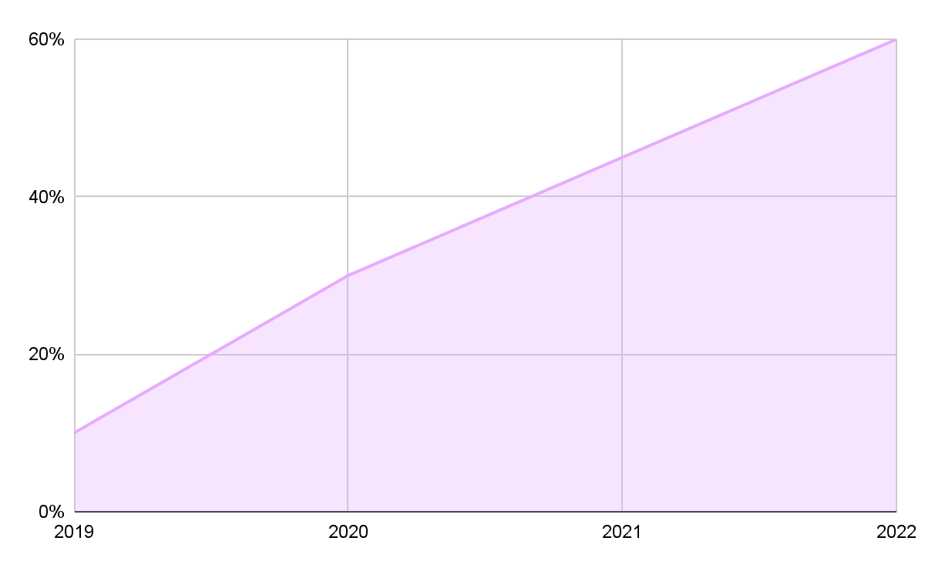
INNOVATION STATUS
OUR ANNUAL PROGRESS
FROM 10% TO 60%
Mercury is the closest planet to the Sun and the smallest one in the Solar System—it’s only a bit larger than the Moon
Follow the link in the graph to modify its data and then paste the new one here. For more info, click here

Slide 46
IMPROVEMENTS
VENUS
MARS
JUPITER
Venus has a beautiful name, but also very high temperatures
It's full of iron oxide dust, which gives the planet its reddish cast
Jupiter is a gas giant and the biggest planet in the Solar System
MERCURY
SATURN
NEPTUNE
Mercury is the closest planet to the Sun and the smallest one
Saturn is composed mostly of hydrogen and helium
Neptune is the fourth-largest planet in the Solar System

Slide 47
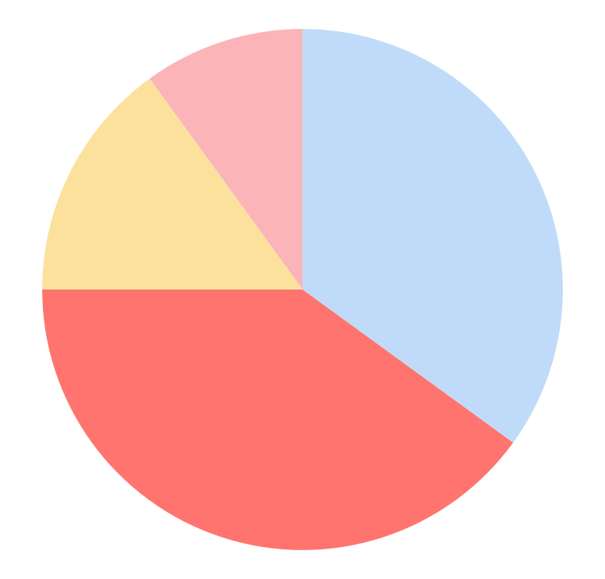
IMPROVEMENTS
45%
VENUS
Venus has a beautiful name, but also very high temperatures
15%
MARS
It's full of iron oxide dust, which gives the planet its reddish cast
10%
SATURN
Saturn is composed mostly of hydrogen and helium
30%
NEPTUNE
Follow the link in the graph to modify its data and then paste the new one here. For more info, click here
Neptune is the fourth-largest planet in the Solar System

Slide 48
TESTIMONIALS
JENNA DOE, 25
SUSAN BONES, 58
JOHN JAMES, 36
TIMMY JIMMY, 47
“Neptune is the farthest planet from the Sun and the fourth-largest by diameter”
“Saturn is a gas giant and has several rings. It's composed mostly of hydrogen and helium”
“Mercury is the closest planet to the Sun and the smallest in the entire Solar System”
“Earth is the third planet from the Sun and the only one that harbors life in the Solar System”

Slide 49
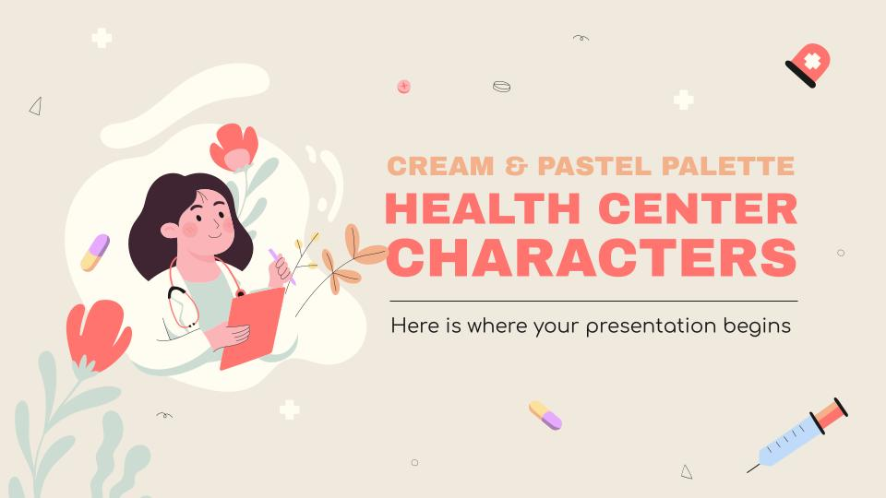
VISIT OUR WEBSITE
You can replace the image on the screen with your own work. Just right-click on it and select “Replace image”

Slide 50
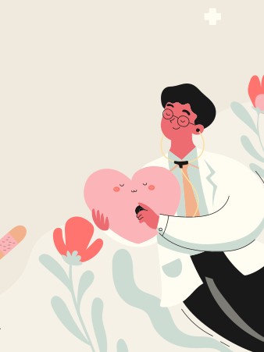
OR YOU CAN USE OUR APP
You can replace the image on the screen with your own work. Just right-click on it and select “Replace image”

Slide 51
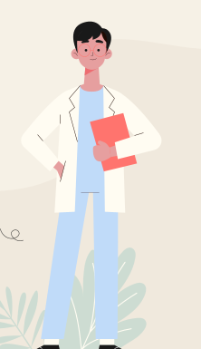
JUST ONE CALL AWAY
You can replace the image on the screen with your own work. Just right-click on it and select “Replace image”

Slide 52
THANKS!
DO YOU HAVE ANY QUESTIONS?
youremail@freepik.com
+91 620 421 838
yourwebsite.com
Please keep this slide for attribution

